Slide 1
SQL PROJECT ON PIZZA SALES
We would like to offer you a stylish and reasonable presentation that will help you to promote your business

Slide 2
HELLO!
My name is Ajit Kumar Gauraw. In this
project I have Utilize a Sql Queries to
solve a question related to pizza sales

Slide 3
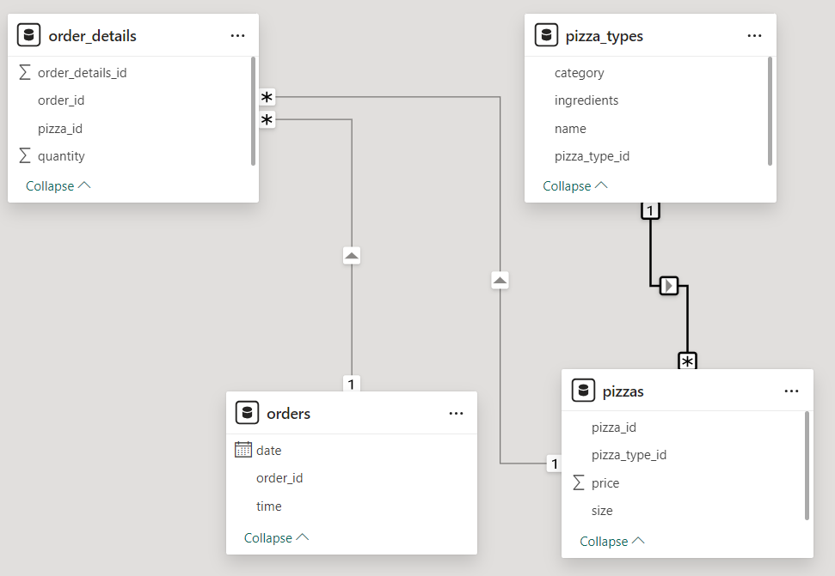
DATA MODEL

Slide 4
QUESTION’S
1.Retrieve the total number of orders placed.
2.Calculate the total revenue generated from pizza sales.
3.Identify the highest-priced pizza.
4.Identify the most common pizza size ordered.
5.List the top 5 most ordered pizza types along With their quantities.
6.Join the necessary tables to find the total quantity of each pizza category ordered.
7. Determine the distribution of orders by hour of the day.
8.Join relevant tables to find the category-wise distribution of pizzas.
9.Group the orders by date and calculate the average number of pizzas ordered per day.
10.Determine the top 3 most ordered pizza types based on revenue.
11.Calculate the percentage contribution of each pizza type to total revenue.
12Analyze the cumulative revenue generated over time.
13.Determine the top 3 most ordered pizza types based on revenue for each pizza category.

Slide 5
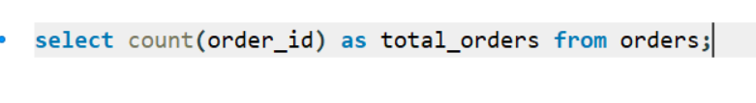
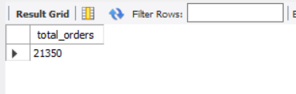
Retrieve the total number of orders placed.

Slide 6
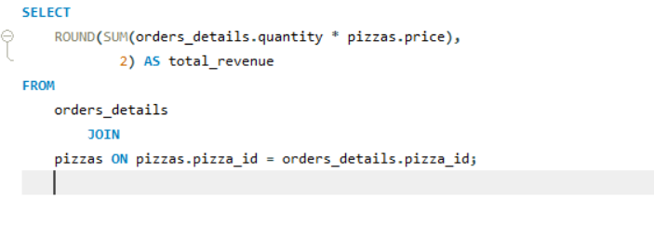
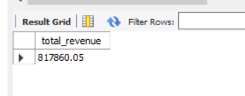
Calculate the total revenue generated from pizza sales.

Slide 7
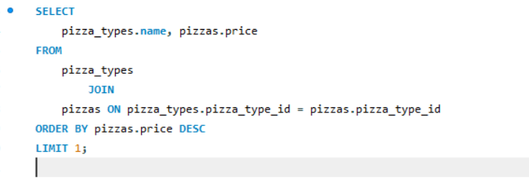
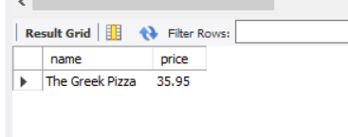
Identify the highest-priced pizza.

Slide 8
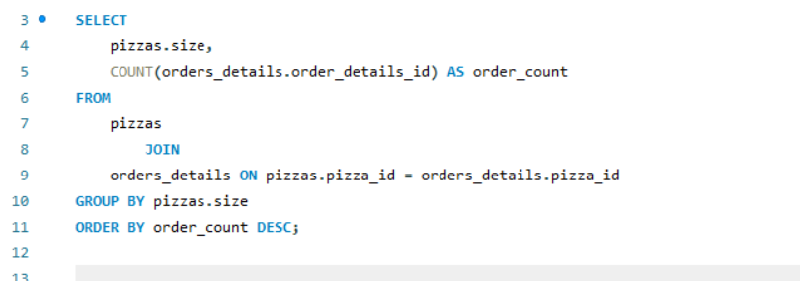
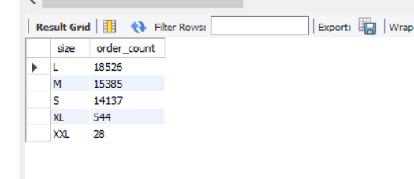
Identify the most common pizza size ordered.

Slide 9
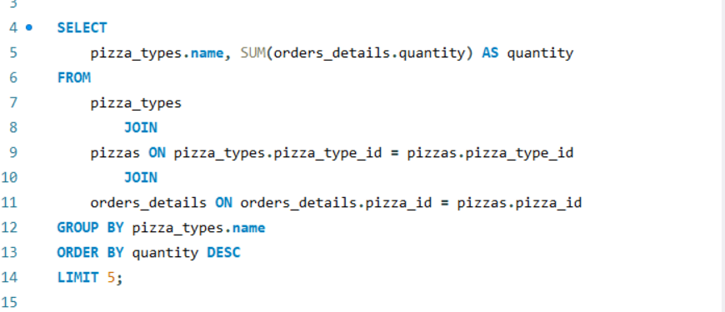
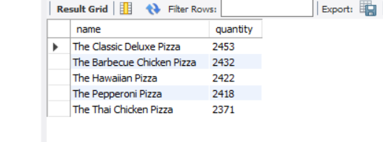
List the top 5 most ordered pizza types along With their quantities.

Slide 10
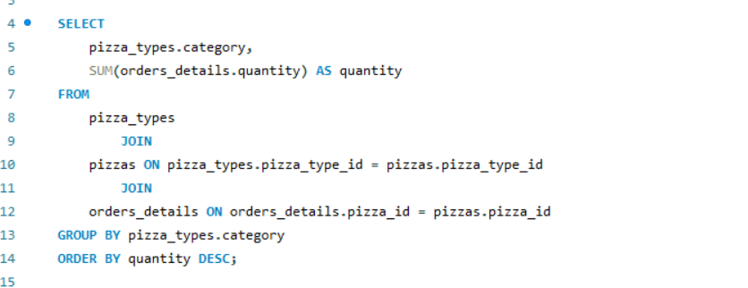
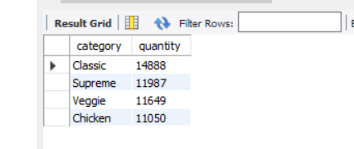
Join the necessary tables to find the total quantity of each pizza category ordered.

Slide 11
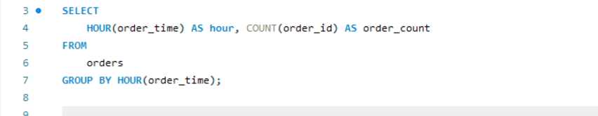
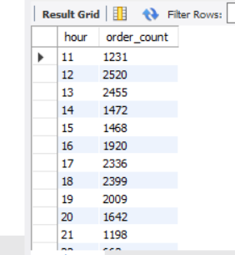
Determine the distribution of orders by hour of the day

Slide 12
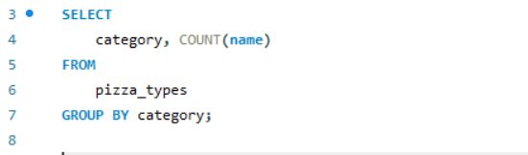
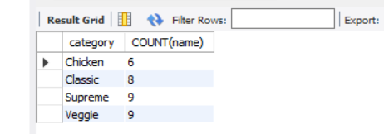
Join relevant tables to find the category-wise distribution of pizzas.

Slide 13
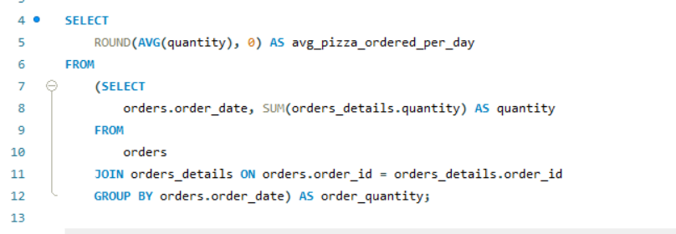
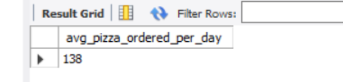
Group the orders by date and calculate the average number of pizzas ordered per day.

Slide 14
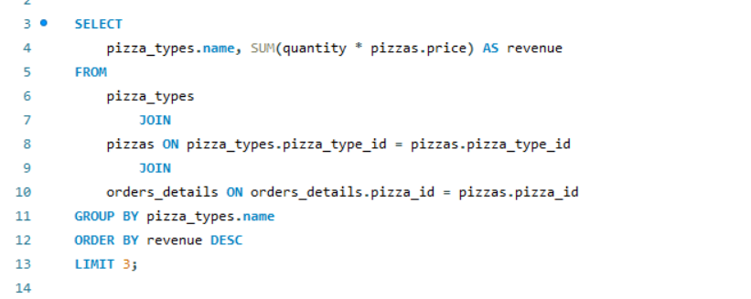
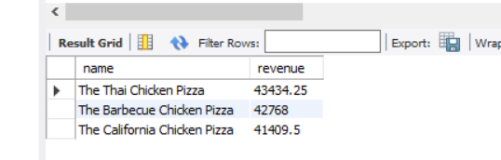
Determine the top 3 most ordered pizza types based on revenue.

Slide 15
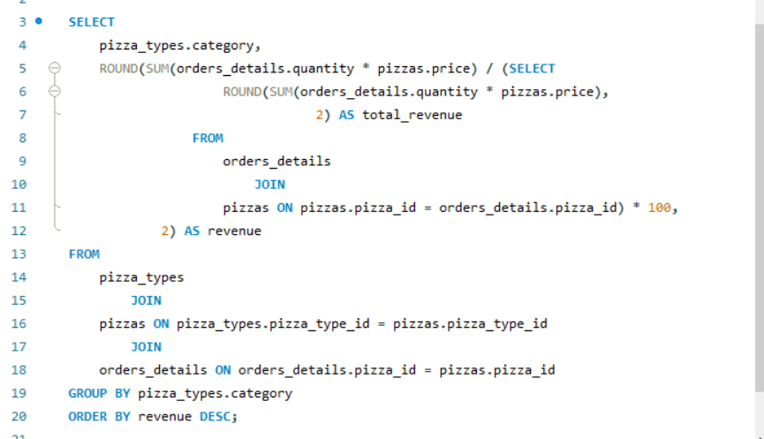
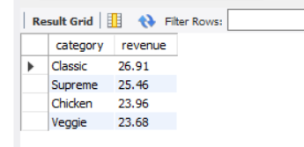
Calculate the percentage contribution of each pizza type to total revenue.

Slide 16
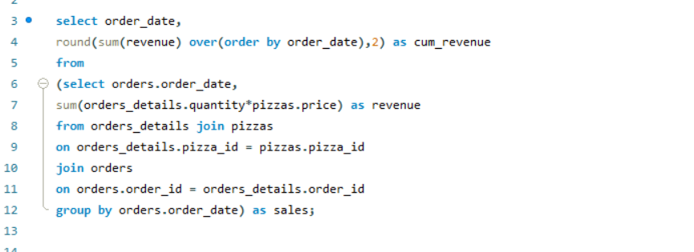
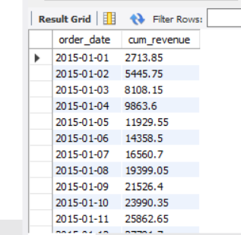
Analyze the cumulative revenue generated over time.

Slide 17
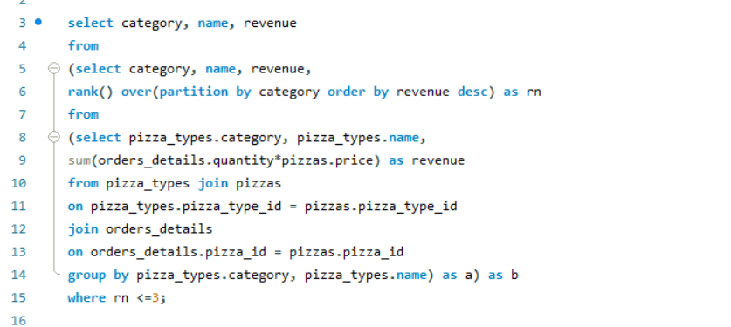
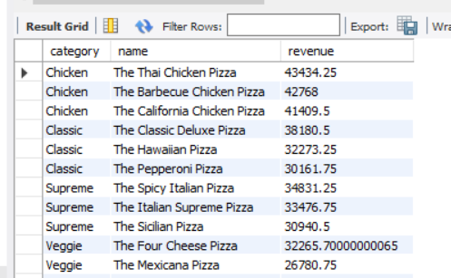
Determine the top 3 most ordered pizza types based on revenue for each pizza category.

Slide 18
THANK YOU

